Slide 1

Final RTES Project
Synchronome & Time-Lapse Image Acquisition
By : Gururaj Athani

Slide 2
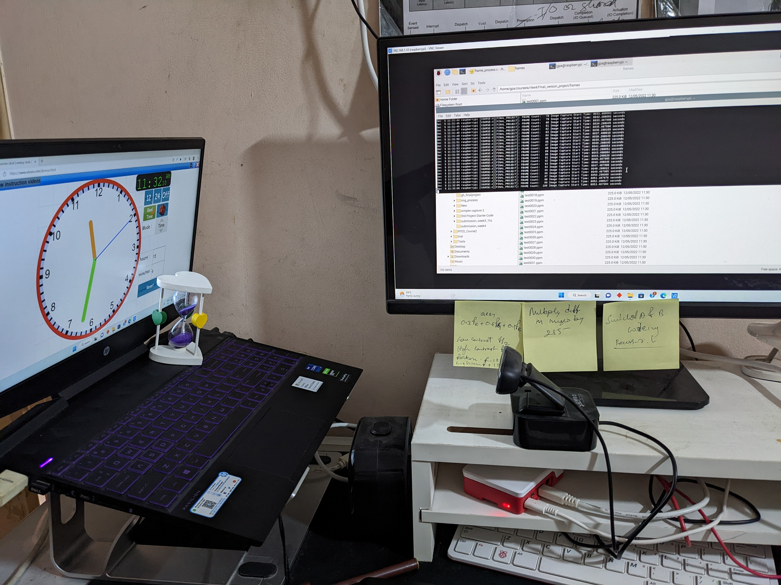
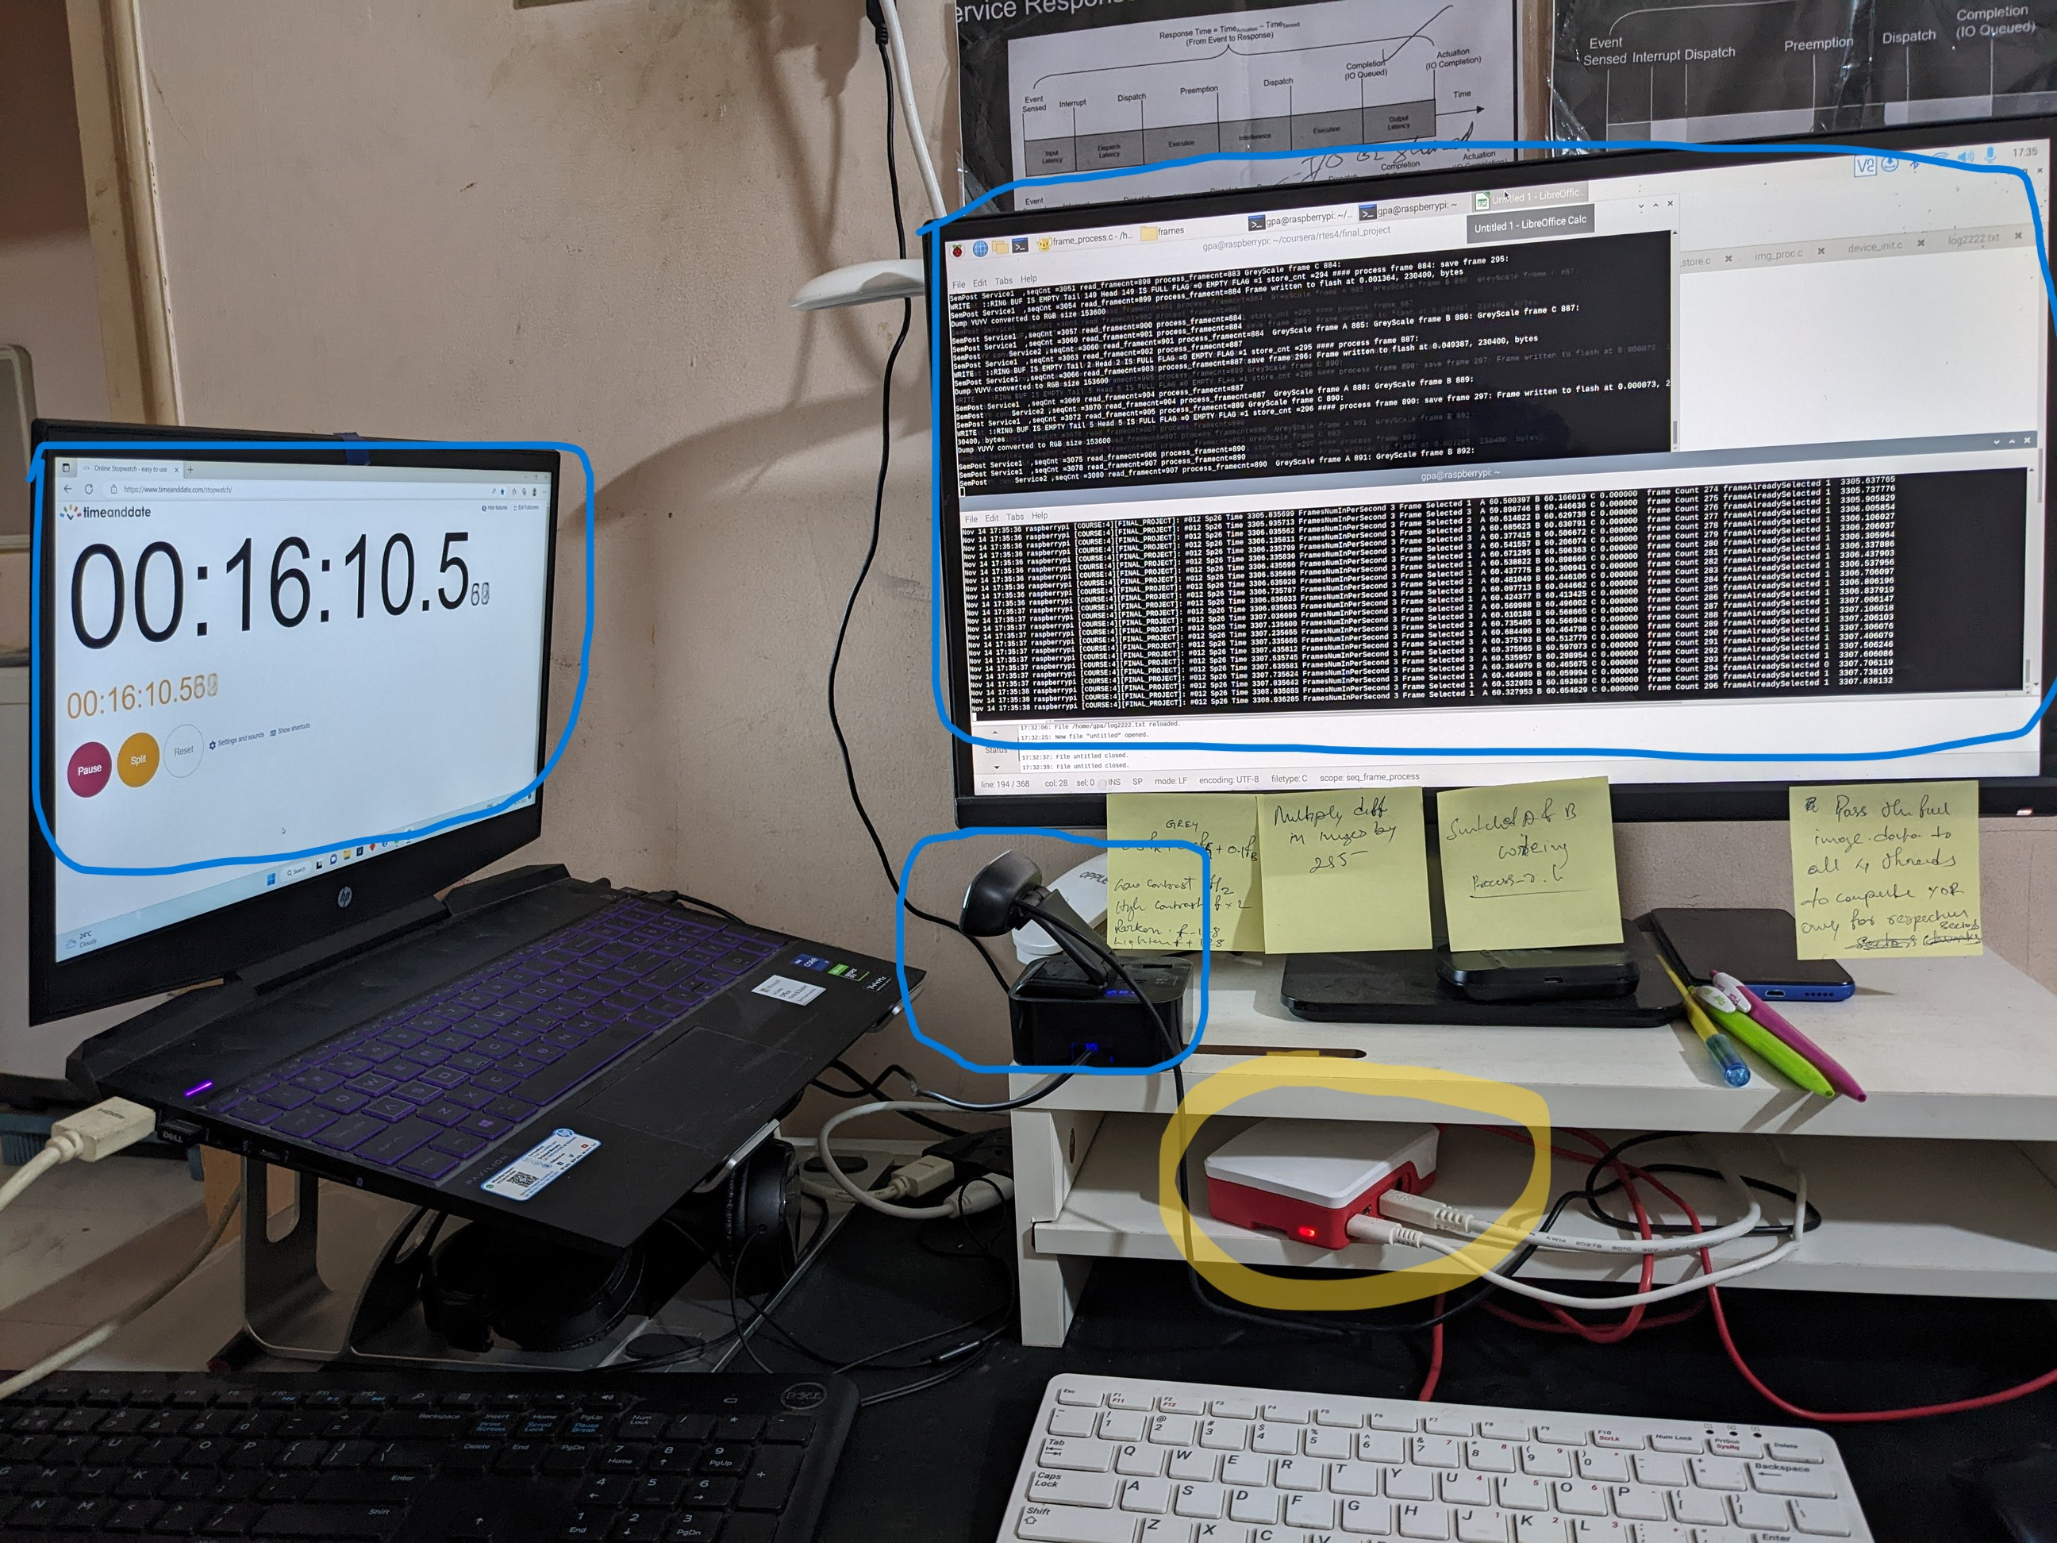
Introduction
The idea is to have a phase lock loop between an external clock(Ticking clock(1Hz) or a Stopwatch(for 10Hz)) and the Software clock executed on an SOC(in this project its Raspberry Pi).
Objective: Capture unique non-blurry , glitch free and drift free images which shows the time lapse :
For 1hz - every tick of the clock
For 10hz - every 100ms
Setup for 1Hz
Setup for 10Hz
Clock
stopwatch
Syslog
Sand timer
Syslog
Logitec cam@30Hz
Logitec cam@30Hz
RaspberryPi
RaspberryPi

Slide 3
Functional (capability) Requirements
1Hz
Use a ticking Analog clock for tick detection
Resolution of the images captured should be at least 320x240
Every tick (or every second) image (no skip or drift) should be detected over a period of 30min
Images captured should be clear without skips, repeats or blurs
Each image saved should have the timestamp from the time of its capture .
Each image should be saved with unique, sequential number (1,2,3 …) corresponding to the tick
10Hz
Use a ticking Digital clock for tick detection
Resolution of the images captured should be at least 320x240
Every tick (or every 1/10th sec) image (no skip or drift) should be detected over a period of 3min
Images captured should be clear without skips, repeats or blurs
Each image saved should have the timestamp from the time of its capture .
Each image should be saved with unique, sequential number (1,2,3 …) corresponding to the tick

Slide 4
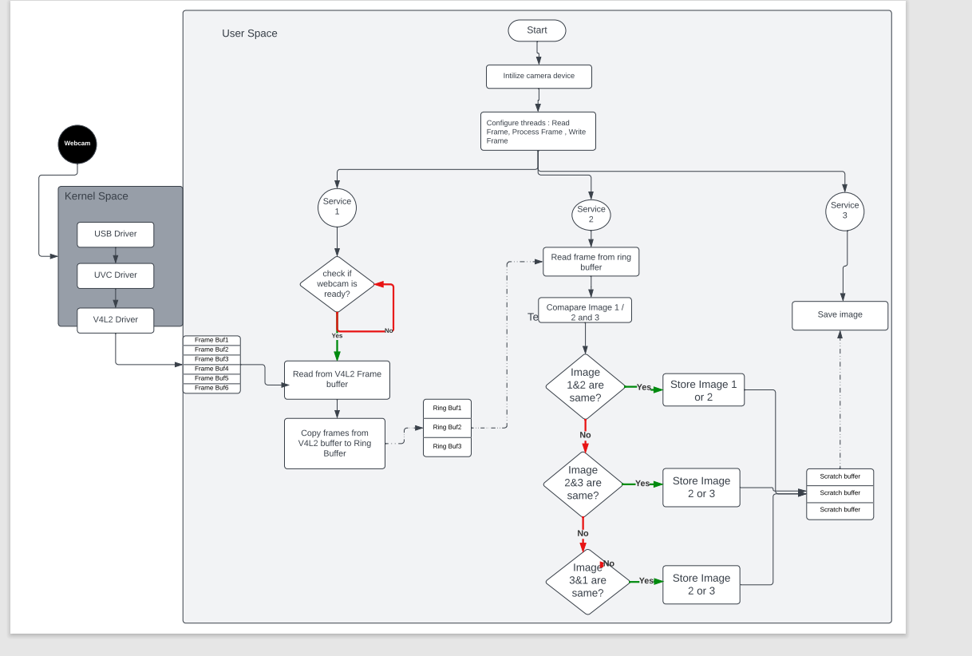
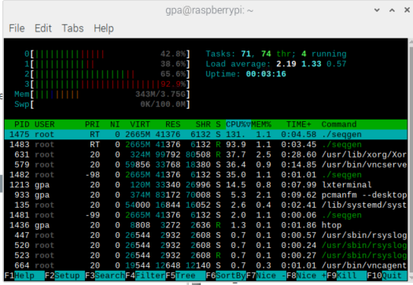
Functional Design Overview and Diagrams
Constraints
Ring Buffer (input/output) – RAM ~ 4GB
Tick and Timing – CPU – 4 cores
I/O Camera – Bounded in case of 10hz. (30Hz Logitech camera, and 3 samples in 100ms)
Input Ring Buffer
Output Ring Buffer

Slide 5
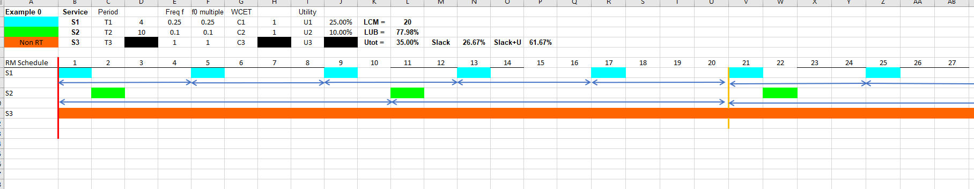
Real-Time Requirements -1Hz
S1 – Read Frames
S2 – Process Frames
S3 - Store Frames
S1 – Read Frames
T- Request rate = 400ms
C – Capacity = 100ms
D- Deadline = 400ms
S2- Process Frames
T- Request rate = 1000ms
C – Capacity = 100ms
D- Deadline = 1000ms
S3- Store Frames
Best Effort,
SCHED_OTHER Service
Tick is : 100ms

Slide 6
Timing Analysis - 1Hz
Glitch - in flash storage, overcome by buffer

Slide 7
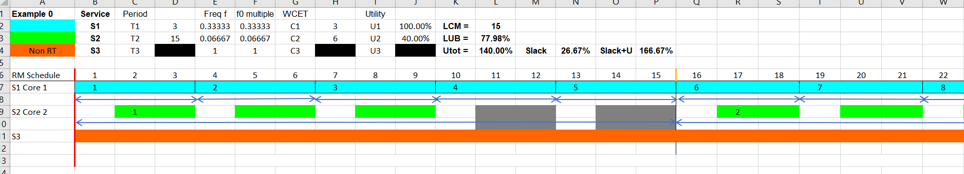



Real-Time Requirements -10Hz
S1 – Read Frames
S2 – Process Frames
S3 - Store Frames
S1 – Read Frames
T- Request rate = 33ms
C – Capacity =33ms
D- Deadline =33ms
S2- Process Frames
T- Request rate = 165ms
C – Capacity = 66ms
D- Deadline = 165ms
S3- Process Frames
Best Effort,
SCHED_OTHER Service
IO Bound, as camera captures at 30Hz
Tick is : 11ms
To avoid being CPU bound, S1 and S2 is running on a different core.(together with Ring Buffer)

Slide 8
Timing Analysis - 10Hz

Slide 10
Conclusion
Setup for 1Hz
1Hz:
Can capture 1801 frames without any glitch, without any constraints,
99% accuracy achieved.
Drift observed between external clock and SW.
10Hz:
The System is I/O bound for 10Hz, as the camera captures frames just under 30Hz.
Can capture 1801 frames with few glitches, glitches due to cache miss? maybe due to ring buffer SW design could improve it.
98% accuracy in timing achieved
There a are few glitches and drift in the frames captured.
Additional Feature:
Filtering (Convolution) introduced, however, the execution time is too high, re-design necessary.
Clock
Syslog
Sand timer
Logitec cam@30Hz
RaspberryPi
Setup for 10Hz
stopwatch
Syslog
Logitec cam@30Hz
RaspberryPi

Slide 11
Timing diagram with convolution feature

Slide 12
Formal References (and Attributions to Anyone who helped)
Dr. Sam Siewert
Peer Reviews and Reviewers

Slide 13
Appendices with results, code etc
Please find the documents (in zip folder)
sched_FinalProject_10Hzand1Hz_2.xls - RMA + Timing analysis
Withaddfeature.xls – timing data with additional feature
Final_version_project.zip : source code, with 10Hz 2nd run frames

